Slide 1


MULTITHREADING

Slide 2
Executer Service
ExecutorService as a higher level replacement for working with threads directly.
Executors are capable of running asynchronous tasks and typically manage a pool of threads, so we don't have
to create new threads manually.
All threads of the internal pool will be reused under the hood for revenant tasks, so we can run as many concurrent tasks as we want throughout the life-cycle of our application with a single executor service.

Slide 3
Creating an ExecutorService
ExecutorService executorService1 = Executors.newSingleThreadExecutor();
ExecutorService executorService2 = Executors.newFixedThreadPool(10);
ExecutorService executorService3 = Executors.newScheduledThreadPool(10);
ExecutorService workStealExecutorService = Executors.newWorkStealingPool(10);

Slide 4
Runnable vs. Callable
public interface Runnable {
public void run();
}
public interface Callable{
public Object call() throws Exception;
}

Slide 5
Execute() vs submit()
The execute() can only accept the Runnable task but submit() can accept both Runnable and Callable task.
The execute() method is declared in the Executor interface while submit() method is declared in ExecutorService interface.
The return type of execute() method is void but submit() method is a Future object

Slide 6
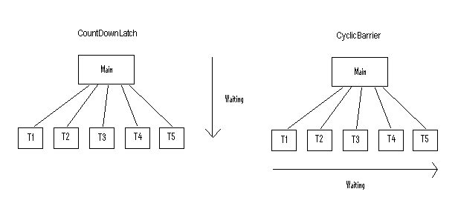
CyclicBarrier and CountDownLatch
CountDownLatch
A thread waits on while other threads count down on the latch until it reaches zero.
CyclicBarrier
A group of threads waits together until all of the threads arrive. At that point, the barrier is broken and an action can optionally be taken

Slide 7
ThreadLocalRandom
Introduced as a Java 7
ThreadLocalRandom is also a random number generator.
ThreadLocalRandom is used in concurrent environment and isolated to current thread

Slide 8
MULTITHREADING

Slide 9
A Queue that additionally supports operations that wait for the queue to become non-empty when retrieving an element, and wait for space to become available in the queue when storing an element.
Blocking queue
A Queue that additionally supports operations that wait for the queue to become non-empty when retrieving an element, and wait for space to become available in the queue when storing an element.
Blocking Queue implementations are designed to be used primarily for producer-consumer queues, but additionally support the Collection interface

Slide 10


Blocking queue

Slide 11
ForkJoin
The fork/join framework was designed to recursively split a parallelizable task into smaller tasks and then combine the results of each subtask to produce the overall result.
It’s an implementation of the ExecutorService interface, which distributes those subtasks to worker threads in a thread pool, called ForkJoinPool
ForkJoinPool
ForkJoinTask
RecursiveAction
RecursiveTask

Slide 12
CompletableFuture
Introduced as a Java 8 Concurrency API improvement
CompletableFuture in java is promises in Javascriptr .
Limitations of Future :
It cannot be manually completed
You cannot perform further action on a Future’s result without blocking
Multiple Futures cannot be chained together
Can not combine multiple Futures together
No Exception Handling

Slide 13
Variations of runAsync() and supplyAsync() methods
static CompletableFuture<Void> runAsync(Runnable runnable)
static CompletableFuture<Void> runAsync(Runnable runnable, Executor executor)
static <U> CompletableFuture<U> supplyAsync(Supplier<U> supplier)
static <U> CompletableFuture<U> supplyAsync(Supplier<U> supplier, Executor executor)

Slide 14
Transformation and action
thenApply()
thenAccept()
thenRun()

Slide 15
Combining two CompletableFutures
thenCompose()
thenCombine()
allOf()
anyOf()

Slide 16
Exception Handling
handle()
Exceptionally()

Slide 17
Locks
Flexible and sophisticated thread synchronization mechanism than the standard synchronized block.
Around since Java 1.5
java.util.concurrent.lock package
provides extensive operations for locking.
ReentrantLock
ReentrantReadWriteLock
StampedLock

Slide 18
Locks
void lock() – acquire the lock if it's available; if the lock isn't available a thread gets blocked until the lock is released
void lockInterruptibly() – this is similar to the lock(), but it allows the blocked thread to be interrupted and resume the execution through a thrown java.lang.InterruptedException
boolean tryLock() – this is a non-blocking version of lock() method; it attempts to acquire the lock immediately, return true if locking succeeds
boolean tryLock(long timeout, TimeUnit timeUnit) – this is similar to tryLock(), except it waits up the given timeout before giving up trying to acquire the Lock
void unlock() – unlocks the Lock instance

